Slide 1
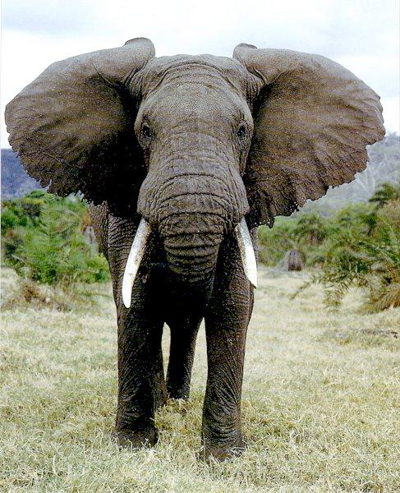
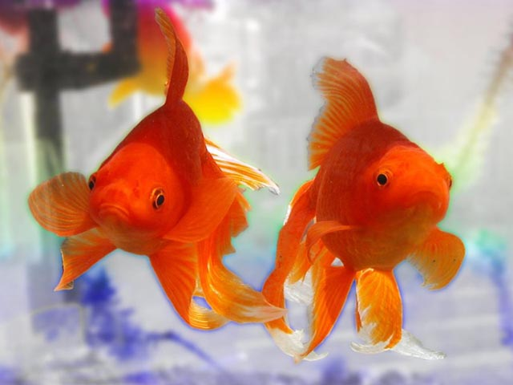
Strategies for Improving Memory
Mnemonics

Slide 2
Examiners often complain that students choose any random strategy when asked in exams.
Some strategies are more suitable for some situations than others.
Always choose a relevant strategy.

Slide 3
Visual Imagery
Many different methods of visual imagery
Imagine something visual in your mind and link the memory with it.

Slide 4
Visual: Method of Loci
Associate parts of the material to be remembered with different places, or points along a route.
For example, a speech can be remembered by identifying key parts and points with different rooms in a house, and by imagining yourself going through each room as you give the speech. The rooms act as retrieval cues.
Pegs – Eye book p

Slide 5
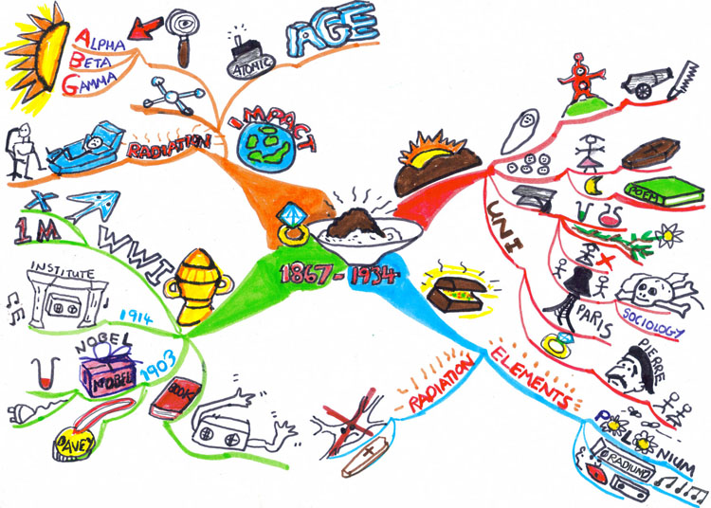
Visual: Spider diagrams and mind maps
Visual ways of representing material, the idea being that you visualise each part and remember what it represents.

Slide 6
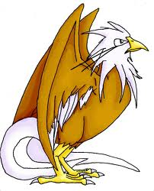
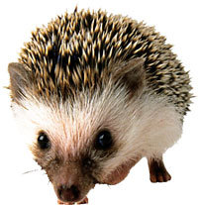
Visual: key words
Key words are useful in language learning, where a mental association needs to be made between an English word and its foreign counterpart.
Some aspect of the word to be remembered is associated with a visual image which prompts the memory of the word in the other language.

Slide 7
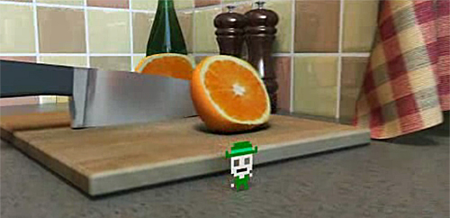
Visual Imagery
Strengths & Weaknesses?
Evaluation: A strength of using visual imagery as a memory aid is that once learnt, the technique can be used regularly. A weakness is that not everyone has the ability to visualise, and so the technique doesn’t suit everybody.

Slide 8
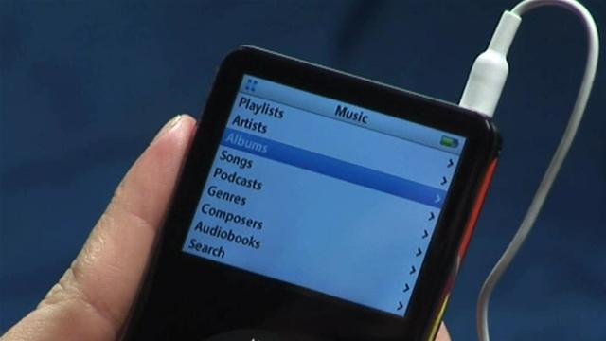
Organisation of information into hierarchies
This is where information can be categorised and remembered more easily
For example, knowing that minerals can be either metals or stones, and that stones can then be sub-classified into rare, common or alloys, and that platinum, silver and gold are all rare metals. (if you can visualise the diagram it helps too)
Evaluate?

Slide 9
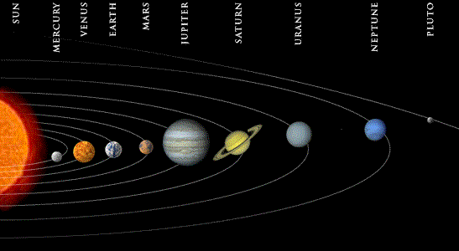
Verbal Mnemonics
These are word related memory aids
What examples do you already know?

Slide 10
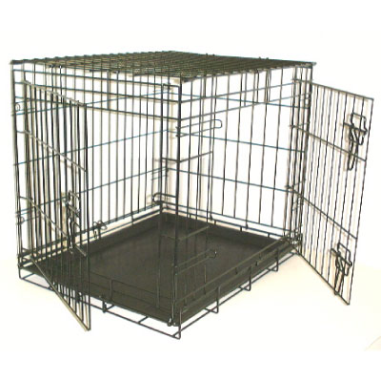
Verbal Mnemonics
Acronyms – these are where you make a word or sentence formed from the first letters of other words. For example, the acronym ROY G BIV for the colours of the rainbow

Slide 11
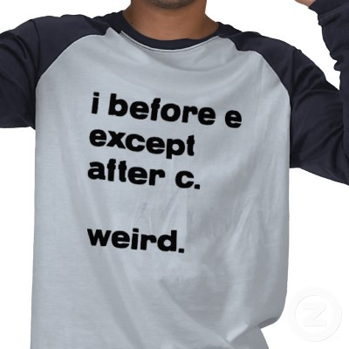
Verbal Mnemonics
Rhymes – these are groups of words on a common theme set to a particular rhythm. Eg. 30 days hath September, April, June and November to help remember how many days each month has.

Slide 12
Verbal Mnemonics
Chunking – this is where a large amount of information is broken down into smaller, more memorable chunks. Eg. A phone number is more memorable if it is chunked into something with which we are familiar: 0208 234 5678.

Slide 13
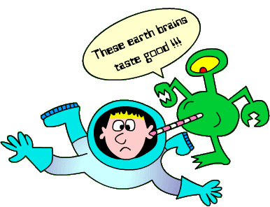
Verbal Mnemonics
Strengths & Weaknesses?
Evaluation: a strength of this method is that it can be very effective for students when having to learn large amounts of information; a weakness is that verbal mnemonics can pose a problem for people with dyslexia.

Slide 14
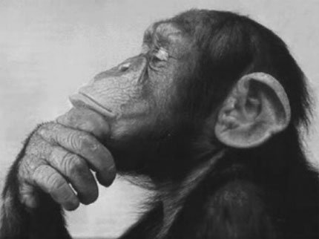
Active / deep processing
The levels of processing model of memory - this suggests that when information is ‘processed’ for its meaning, this deep semantic processing leads to enhanced recall of that information.
Such deep processing involves elaborative thinking, which is where you think around an idea, and link it to other ideas or things that you know.
This in contrast with shallow processing of information (not really thinking about it much), which is where only superficial characteristics are noticed. Shallow processing leads to poorer recall.

Slide 15
Active/deep processing
Evaluation: a strength of this technique is that the ideas that the ideas that it proposes are empirically supported; a weakness of the technique is that it is unclear whether it is simply the increased effort and attention involved in deep processing that leads to the enhanced recall (ie. it’s unclear exactly what ‘deep processing’ is).

